Slide 1

School of Engineering and Technology
Department of Electronics and Communication Engineering
Capstone Project
On
"Implementation of Vehicle Accident Detection and Prevention System”
Project guide
Dr. Karabi Baruah
Assistant Professor
Team Members
Sachin N - 21BBTEC039
Soundarya S Badiger - 21BBTEC044
Surinedi Thrivedhi - 21BBTEC048
T Mallikarjuna Reddy - 21BBTEC049

Slide 2
CONTENT
Introduction
Literature survey
Research Gap
Objective
Methodology
Block diagram
Circuit diagram
Flow chart
System Components
Implementation
Result
Accident Rates in India
Reasons for Accidents
Applications
Advantage
References
Conclusion

Slide 3
INTRODUCTION
Improves road safety using modern technologies like ESP32, GSM, GPS, and various sensors.
Detects unsafe driving behavior and provides quick emergency assistance. Includes:
Eye blink sensors to detect driver fatigue or drowsiness.
Alcohol sensors to monitor intoxication levels.
MEMS sensors to detect vehicle tilting or accidents.
Tracks vehicle location in real-time using Google Maps.
Sends real-time emergency alerts to authorities or family members during accidents.
Helps prevent accidents caused by:
Drowsy driving
Alcohol consumption
Reckless or sudden movements
Assists in the recovery of lost or stolen vehicles.
Promotes driver awareness, accident reduction, and provides peace of mind to both drivers and passengers.
.

Slide 4
LITERATURE SURVEY
AUTHOR | TITTLE, YEAR | OUTCOME
Mohd Faizal bin Yusof Andrii Oliinyk | Enhancing Vehicle Safety: A Comprehensive Accident Detection and Alert System , 2023 | The paper discusses a smart accident detection and alert system that uses sensors and GPS to quickly detect vehicle crashes and send emergency alerts, improving road safety and reducing response time.
2. Swetha A Pooja S Tejas B R | VEHICLE SAFETY DETECTION USING IOT , 2024 | This paper proposes an IoT-based system that detects vehicle accidents using sensors and sends alerts to help save lives.
3.Prashant Shigwan Sakshi Dhondkar | ACCIDENT MITIGATION SYSTEM WITH DROWSINESS DETECTION , 2024 | This paper explain road accidents caused by factors such as drowsiness and fatigue. The quickest way to determine drowsiness by SMS,CALL Alerts
4.Tarak Hossain Divi Yaswanth | Vehicle Safety System with Alcohol Detection and Accident Recognition ,2024 | This system prevents drunk driving by shutting down the vehicle and sends GPS alerts in case of accidents or fire to help emergency responders.
5.Babatunde A. A Omodeni C. B | Design and Implementation of a Sensor-Based Machine Overheat Protection System with Alarm Notification , 2024 | This system uses a microcontroller to detect overheating, cool it with a fan, trigger an alarm and SMS alerts if it Declines, and shut down if needed for safety.

Slide 5
AUTHOR | TITTLE, YEAR | OUTCOME
6. K. Krishna Jyothi G. Kalyani | COMPUTER VISION BASED ACCIDENT DETECTION AND ALERT SYSTEM, 2023 | The paper introduces a computer vision-based system that leverages real-time video analysis and object detection to identify road accidents and send automated alerts.
7. John Hourdos Vishnu Garg |  | The paper presents an automated system that uses traffic condition analysis and pattern recognition to detect accident-prone scenarios and proactively prevent potential collisions.
8. D.Sai Santosh , E.Bhargava Reddy | Automatic Driver Drowsiness Detection and Accident Prevention System using Image Processing , 2024 | Effective real-time driver fatigue detection using Viola-Jones and Timm-Barth algorithms.
9. Anil Kumar Biswal Debabrata Samanta | IoT-Based Smart Alert System for Drowsy Driver Detection, 2023 | Non-intrusive driver drowsiness and collision severity detection using facial landmarks, sensors, and GPS.
10. Tarani Sunil Merugumala Naga | Conceptual Framework For Accident Detection And Prevention , 2023 | Live speed tracking and accident location reporting via mobile app for faster emergency response.
Accident Prevention Based on Automatic Detection of Accident Prone Traffic Conditions, 2024

Slide 6
AUTHOR | TITTLE, YEAR | OUTCOME
11. OGUOMA IKECHUKWU STANLEY | OGUOMA IKECHUKWU STANLEY ,2023 | IoT-based system for real-time vehicle overheating detection using smart temperature alarm architecture.
12. Pratik Powar Atharv Nakti | A Survey on IoT-Based Vehicle Accident Prevention and Emergency Notification System | IoT-based system integrating real-time accident prevention and emergency notification using ESP32, RF modules, and Blynk app for autonomous vehicle safety.
13. SANGEETHA .M SUJITHA. B | IOT BASED VEHICLE ACCIDENT PREVENTION USING MULTIPLE SENSORS | IoT-based accident prevention system using multiple sensors for real-time vehicle monitoring.
14. Meghana A Bharath M R | ESP32 based embedded system for level I vehicular automation using iot ESP32 ased Embedded System for Level I Vehicular Automation sing IoT. | ESP32-based IoT system enabling Level I vehicular automation with real-time safety monitoring.
15. Rajat Gupta | A Simulink Model for an Engine Cooling System and its Application for Fault Detection in Vehicles | Simulink-based engine cooling model for real-time vehicle fault detection and diagnostics.

Slide 7
RESEARCH GAP
Use of ESP32 Microcontroller: The system is built using the ESP32, a powerful yet affordable microcontroller with built-in Wi-Fi and Bluetooth, making it ideal for real-time communication in IoT applications without needing external modems.
C Programming for Embedded Control: The entire system logic, including sensor data processing, decision-making, and communication protocols, is implemented using C programming, which provides efficient and fast execution necessary for time-critical applications like accident detection.
Real-Time Multi-Sensor Integration:
Accelerometer for impact detection
Eye Blink Sensor to monitor drowsiness or unconsciousness
Alcohol Sensor to detect intoxication before or during driving These sensors are interfaced with the ESP32 to monitor driver behavior and detect abnormal conditions in real time.

Slide 8
Automatic Hospital Notification System: Once an accident is detected, the system automatically sends an alert containing GPS coordinates to nearby hospitals or emergency responders using Wi-Fi communication, eliminating the need for human intervention.
Standalone and Scalable: Unlike smartphone-dependent systems, this project offers a standalone solution that can be installed in any vehicle. Its low cost and open-source nature make it scalable for widespread use, even in low-resource environments.
Educational and Social Impact: This initiative serves as a practical application of ESP 32, IoT, embedded systems, and C programming, offering valuable learning experiences for developers while addressing a major public safety issue through automation.
.

Slide 9
OBJECTIVE
The primary aim of this project is to significantly reduce the incidence of accidents that can be attributed to driver-related issues such as alcoholism, Eye blink, Vehicle tracking and some issues. The GPS and GSM system can be used to determine over speed in restricted area and charge penalty automatically decreasing human manpower, saving time and money. Reporting system can be used with Home security, personal security connecting with family, vehicle security .And many more .If an accident occurs due to other reasons, the system is designed to immediately send an alert message with the exact location of the incident to emergency services, including the police and ambulance. This allows for a quick response to help the victims, reduce fatalities, and improve road safety
.

Slide 10
METHODOLOGY
1.Power Connection
Connect the main power supply to the breadboard.
Ensure the correct voltage and current for all components.
2. Microcontroller Setup (ESP32)
Place the ESP32 microcontroller on the breadboard.
Connect the power (VCC and GND) to the circuit.
Attach required input/output pins for sensors, motors, and modules.
3. Sensor Connections
Accelerometer (GY-521): Connect VCC, GND, and data pins (SCL, SDA) to ESP32.
GPS Module: Connect TX/RX to ESP32 serial pins.
Temperature & Humidity Sensor (DHT11): Connect VCC, GND, and data pin to ESP32.
IR Sensor: Connect power and signal pin to ESP32.

Slide 11
4.Actuators & Output Devices
Motor Driver (L298N): Connect to ESP32 and DC motors.
LCD Display : Connect data pins to ESP32 for displaying information.
Buzzer & LED : Connect to ESP32 for alerts.
5. Storage & Communication
SD Card Module: Connect SPI pins (MISO, MOSI, SCK, CS) to ESP32 for data logging.
6. Testing & Debugging
Power on the circuit and check all connections.
Use a multimeter to verify voltages.
Upload test code to ESP32 and check outputs.
7. Final Integration
Run the complete program.
Ensure all sensors, motors, and displays function as expected.
Optimize code and connections for efficiency.

Slide 12
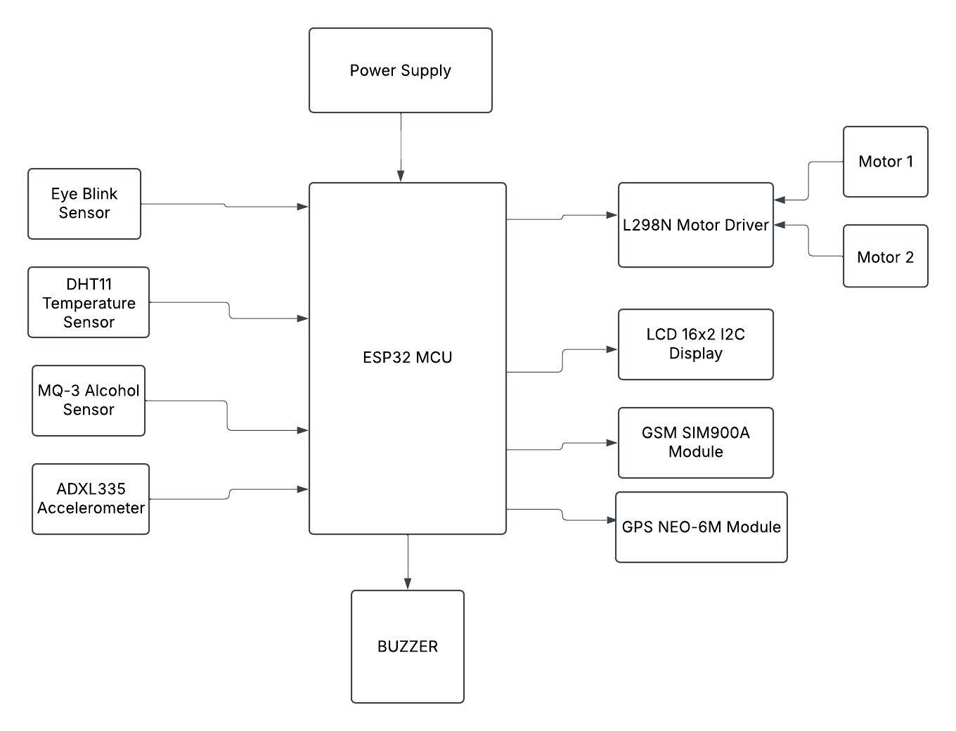
BLOCK DIAGRAM

Slide 13
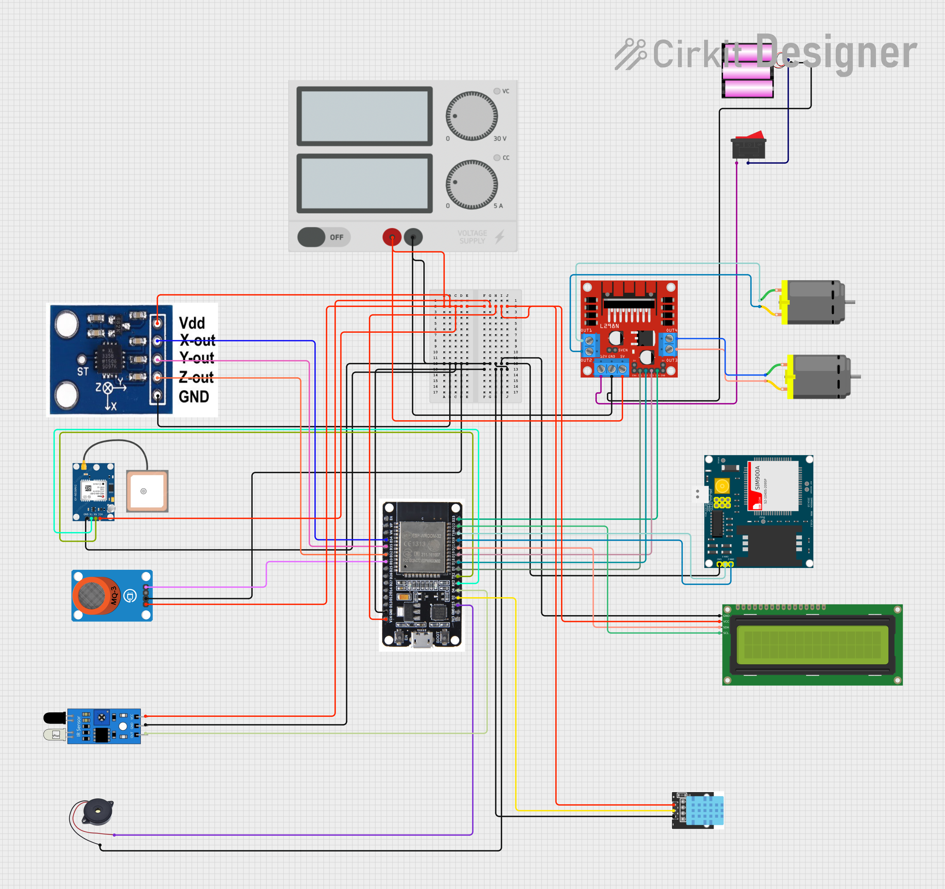
CIRCUIT
DIAGRAM

Slide 14
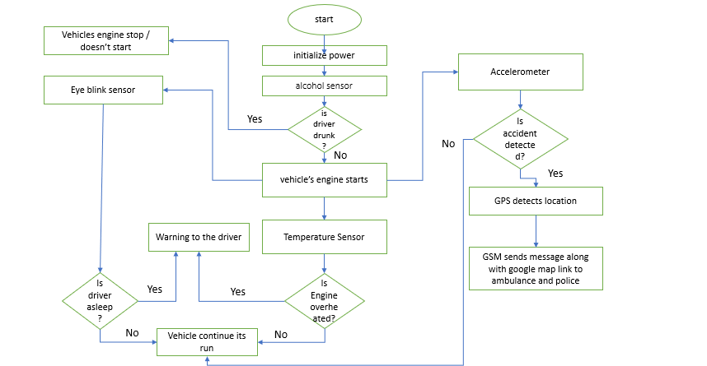
FLOW CHART

Slide 15
HARDWARE AND SOFTWARE COMPONENTS
HARDWARE COMPONENTS
ESP 32
Power supply
Eye Blink sensor
Alcohol sensor
MEMS ADXL335 Accident Sensor
Obstacles IR Sensor
16×2 LCD display
GSM SIM800L
GPS-GYGPS6MV2
ENGINE -DC MOTOR
Alarm/buzzer
Temperature Sensor
SOFTWARE COMPONENTS
1 Programming language C
2 Arduino compiler

Slide 16
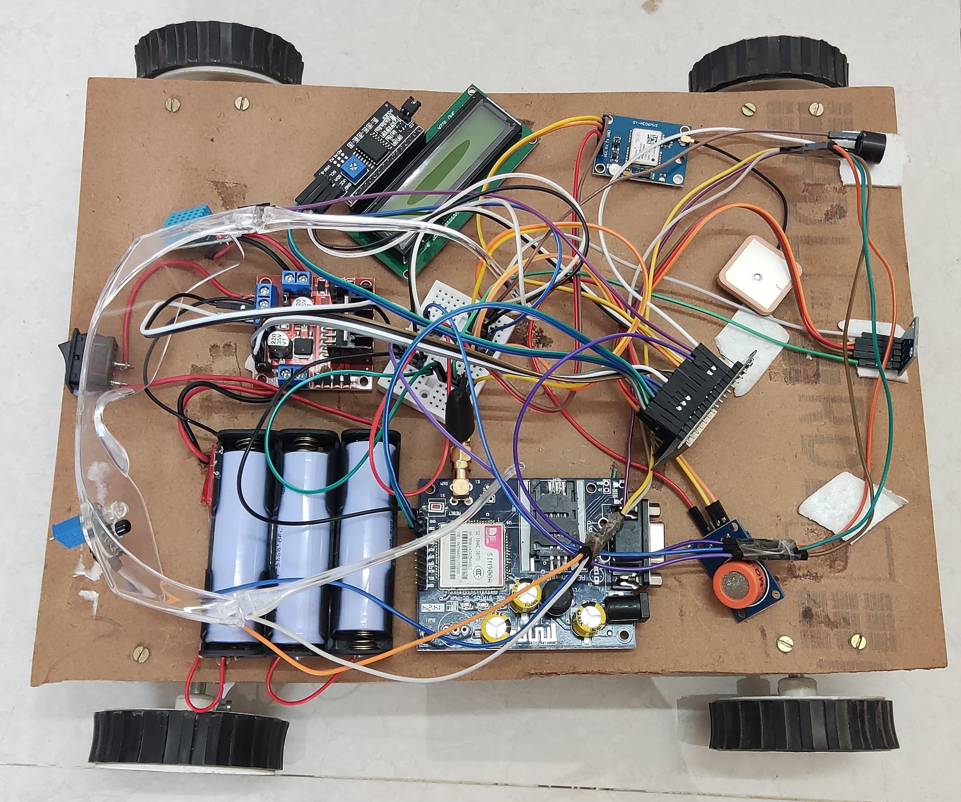
IMPLEMENTATION
The ESP32 collects data from all sensors. If an accident is detected (ADXL 335), it activates a buzzer, shows a warning on LCD, and sends an emergency SMS with location. If alcohol is detected (MQ-3), the motor stops and send SMS and call for emergency number. Drowsiness (Eye Blink Sensor) show warning on LCD ,sends a SMS to emergency number, high temperature (DHT11) activates a buzzer and sends SMS to emergency number

Slide 17
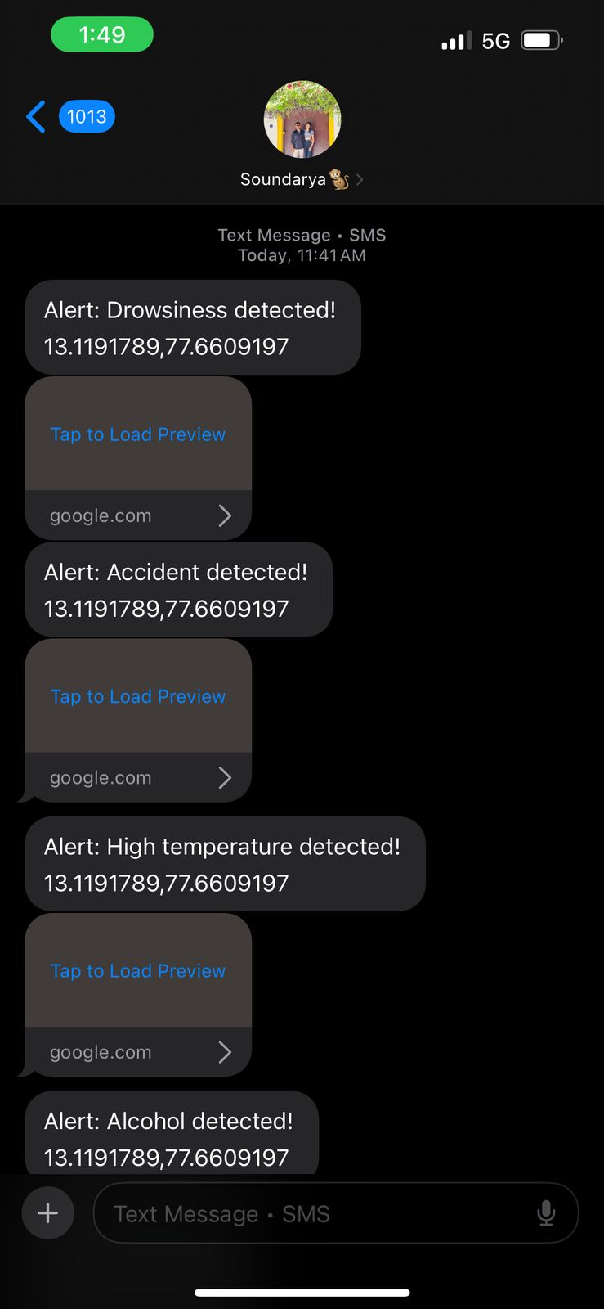
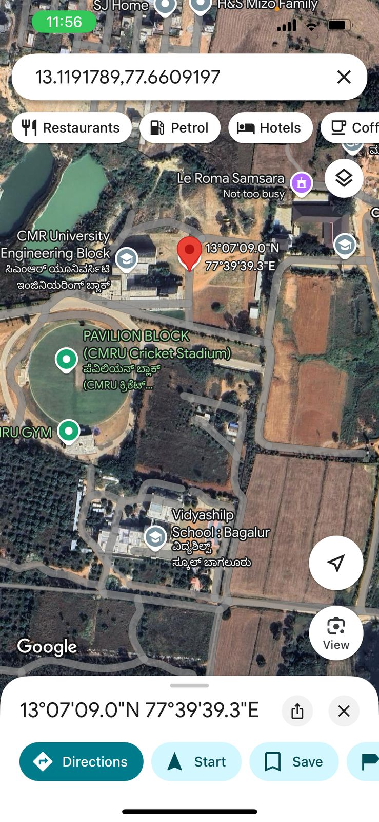
RESULT

Slide 18
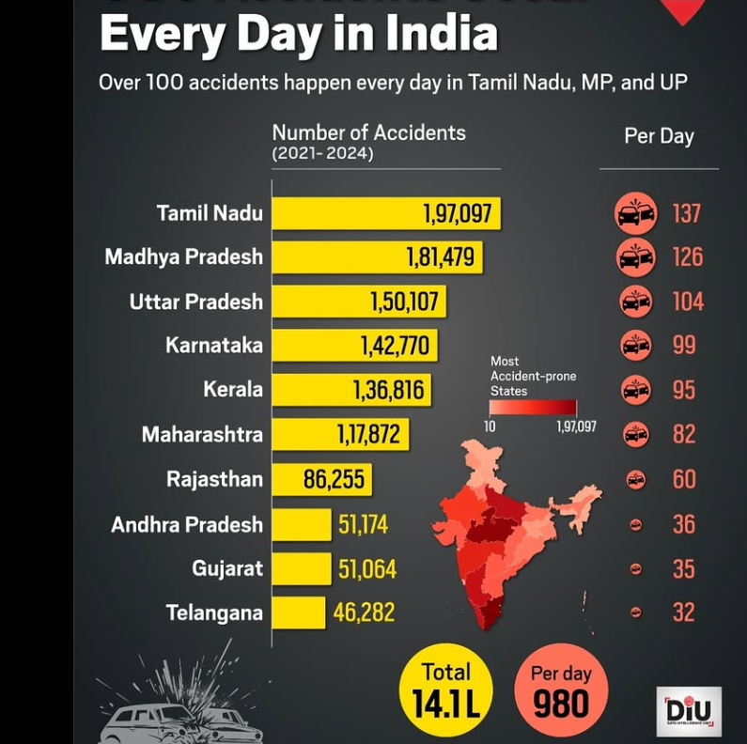
ROAD ACCIDENTS RATES
IN INDIA

Slide 19
ACCIDENT DUE TO SOME REASONS

Slide 20
APPLICATIONS
Driver Fatigue Monitoring
Alcohol Detection
Engine Overheating Alerts
Accident Detection and Reporting
GPS-based Location Tracking
Emergency Response Alerts
Vehicle Tracking System
Speed Monitoring
Fire Detection
Vehicle Health Monitoring

Slide 21
ADVANTAGES
Low Cost
Energy Efficient
Fast Processing
Versatile
GPS Integration
GSM Compatibility
User-Friendly
Reliable
Customizable
Durable, Scalable and Portable
Real-Time Alerts
Improves Safety
Easy Maintenance
Widely Supported
Environmentally Friendly
Accessible to All

Slide 22
DISADVANTAGES
Limited Processing Power.
Limited Memory.
No Built-in Wireless Connectivity.
Dependence on External Power Source.
Vulnerability to Environmental Factors.
Not Ideal for Complex Systems.
Shorter Lifespan Compared to Industrial Systems

Slide 23
REFERENCES
A Comprehensive Accident Detection and Alert System Jamil Abedalrahim Jamil Alsayaydeh, Mohd Faizal bin Yusof, Mohamad Amirul Aliff bin Abdillah, Andrii Oliinyk ,2023.
VEHICLE SAFETY DETECTION USING IOT Swetha A, Pooja S,Tejas B R, 2024.
ACCIDENT MITIGATION SYSTEM WITH DROWSINESS DETECTION Prashant Shigwan Sakshi Dhondkar, 2024.
Vehicle Safety System with Alcohol Detection and Accident Recognition Tarak HossainDivi Yaswanth ,2024.
Design and Implementation of a Sensor-Based Machine Overheat Protection System with Alarm Notification Babatunde A. A, Omodeni C. B , 2024

Slide 24
Hahad Al-Youif., Musab A. M. Ali, M. N. Mohammed, “Alcohol Detection For Car Locking System'', 978-1-5386-3527-8/18/$31.00 ©2018 IEEE.
Nikhil Kumar, Debopam Acharya, Divya Lohani, “An IoT-Based Vehicle Accident Detection and Classification System using Sensor Fusion”, IEEE Internet of Things Journal, January 2021, Volume 8, Issue 2, Pages 869-880.
Shrushti V. Alcohol Detection System with Alert Notification Application. IJERT. 2021; 10(6): 2278-0181.
Aditya Ranjan, Karan Vyas, Sujay Ghadge, Siddharth Patel, Suvarna Sanjay Pawar, “Driver Drowsiness Detection System Using Computer Vision.”, in International Research Journal of Engineering and Technology(IRJET), 2020.
Yang, C.; Xi, H.; Wang, M. Structure optimization of air-cooling battery thermal management gadget based totally on lithium-ion battery. J. Energy Storage 2023, 59, 106538.

Slide 25
COMPUTER VISION BASED ACCIDENT DETECTION AND ALERT SYSTEM 1K. Krishna Jyothi , 2G. Kalyani , 3G. Jhansi Lakshmi, 2023.
Varsha Dange, Ayush Patni, Rohit Patil, Rahul Ponnuru, Siddhant Pawar & Pavan Bhadane IOT based detection of vehicle accident and an emergency help using application interface, Feb 2023, pp. 1-5.
A. Bäuerle, C. van Onzenoodt and T. Ropinski, "Net2Vis – A Visual Grammar for Automatically Generating Publication Tailored CNN Architecture Visualizations," in IEEE Transactions on Visualization and Computer Graphics, vol. 27, no. 6, pp. 2980-2991, 1 June 2021, doi: 10.1109/TVCG.2021.3057483.
Xavier Glorot, Antoine Bordes, Yoshua Bengio, “Deep Sparse Rectifier Neural Networks” Proceedings of the Fourteenth International Conference on Artificial Intelligence and Statistics, 2011.

Slide 26
CONCLUSION
This project aims to reduce accidents caused by these issues like drunk driving, driver fatigue, and engine overheating, which may lead to fires . The system is automatic, affordable, and energy-efficient, making it easy to install in different vehicles. It monitors the vehicle for potential risks, such as driver impairment or engine problems, and acts to prevent accidents. If an accident occurs, the system can detect it automatically. It uses GPS technology to find the exact location of the accident. This information is sent to emergency services through a GSM module. This fast notification helps rescue teams respond quickly, potentially saving lives. The system is designed to be cost-effective so that it is accessible to everyone. It can be installed in all types of vehicles without difficulty . Overall, this project focuses on making roads safer and reducing the number of accidents. By addressing common causes of accidents and ensuring timely help, it aims to protect lives, improve vehicle safety and decrease death rate.

Slide 27
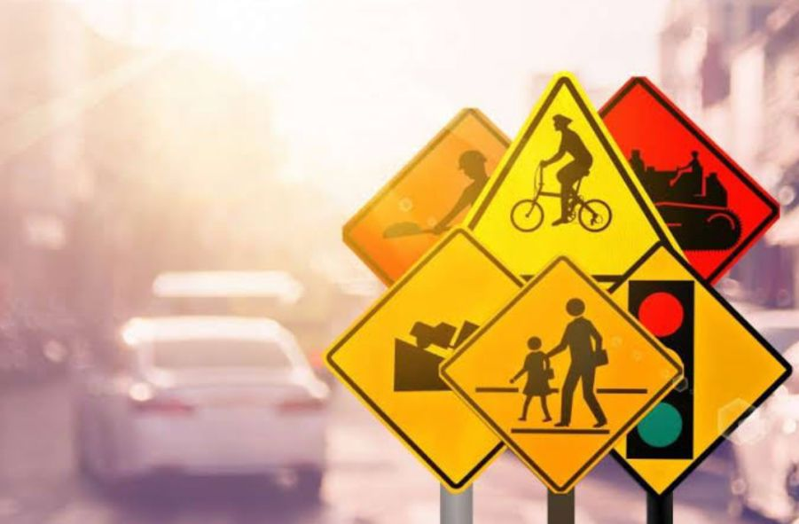
THANK YOU

